Slide 1
RUPlanner
Nick Guida
Steven Lu

Slide 2
Recap
Combination of degree navigator + course planner
Total credits needed
Required courses
Fill in courses as needed
Planner for entire academic career
Easy and intuitive UI
Only works for Engineers

Slide 3
Current Progress
Login Verifies with Rutgers servers
Working Webpage (html/css/php)
Database development backend (MySQL)
Numerous Databases
Courses
Users
Majors
Frontend <> Backend Integration

Slide 4
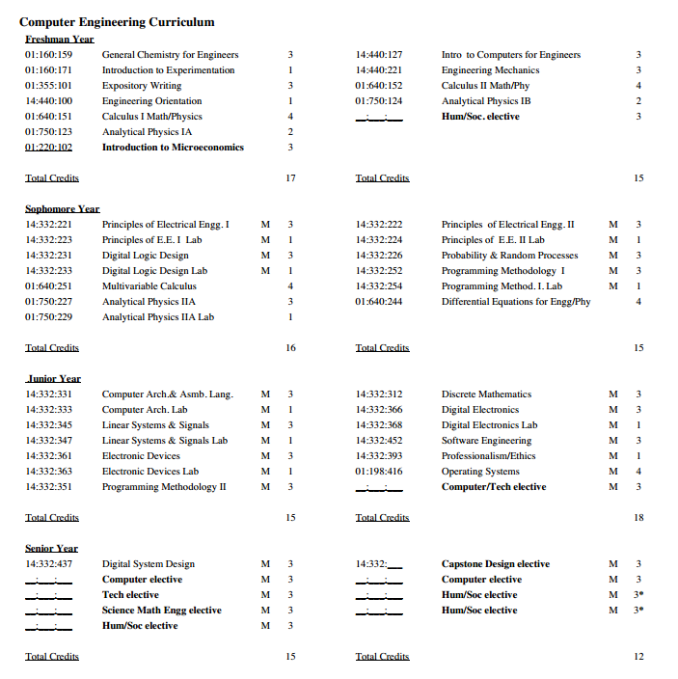
Design/Implementation
Login using NetID/password
Select Major
Prefilled template
Able to add/delete courses with prereqs shown
Progress bar and total credits needed displayed
Course Descriptions
Save/Change/Delete

Slide 5
Difficulties
Database creation
Pulling information from websites
Creating an intuitive UI
Fluid
Looks nice
Displays information cleanly
Recommendation Algorithms

Slide 6
Original vs New Plan
Original plan:
Full Front end (deliverable 1)
Full Back End (deliverable 2)
Integration (deliverable 3)
New Plan:
Working Front end + Working Back end (deliverable 1)
Working demo (deliverable 2)
Everything working + extra (deliverable 3)

Slide 7
Future Deliverables
Deliverable 2
Working UI
Working ECE planner with functional courses
Correctly displayed graduation information
Deliverable 3
Server sider algorithms
Working planner for all Eng. Majors
Potential other bells and whistles (sharing via social media, UI refinement, etc)

Slide 8
Contributions
Steve
Website design/development
Front end programmer
Nick
Database designer/programmer
Presenter/writer/editor

